Slide 1
UNIT – V

Slide 2
Linear Time Series Models
Autoregressive:
Autoregressive (AR) is a type of statistical model that is used to describe time series data.
In an autoregressive model, the value of a variable at a particular time is assumed to be a linear function of its previous values and a random error term.
This model is based on the idea that past values of a variable have a significant influence on its future values.
The general form of an autoregressive model of order p (AR(p)) is expressed as:

Slide 3
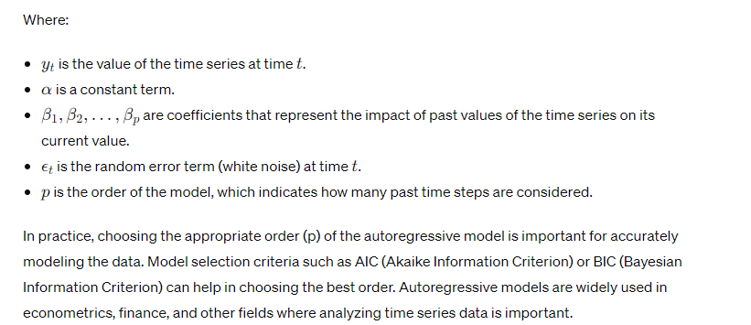

Slide 4
Moving Average
The Moving Average (MA) model is a type of statistical model used to analyze time series data.
In a Moving Average model, the value of a variable at a particular time is assumed to be a linear combination of a specified number of past random error terms (white noise) plus a constant term.
This model is based on the assumption that the current value of the series is influenced by recent random shocks or noise in the data.

Slide 5
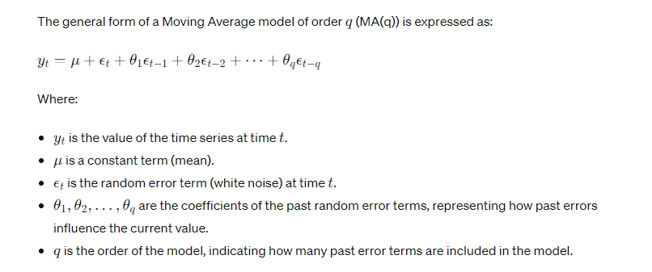

Slide 6
In practice, the Moving Average model is often used in conjunction with the Autoregressive model to form the Autoregressive Moving Average (ARMA) model.
This combination can be useful for capturing both the autocorrelation and the white noise components in the time series data.
Choosing the appropriate order (q) for the Moving Average model is important for achieving the best fit for the data.
Model selection criteria such as AIC (Akaike Information Criterion) or BIC (Bayesian Information Criterion) can help guide this choice.

Slide 7
Autoregressive Moving Average and Autoregressive Integrated Moving Average models
Autoregressive Moving Average (ARMA) and Autoregressive Integrated Moving Average (ARIMA) are statistical models used for analyzing and forecasting time series data.
Both models combine autoregressive (AR) and moving average (MA) components, but ARIMA includes an additional integration (I) component for handling non-stationary time series data.

Slide 8
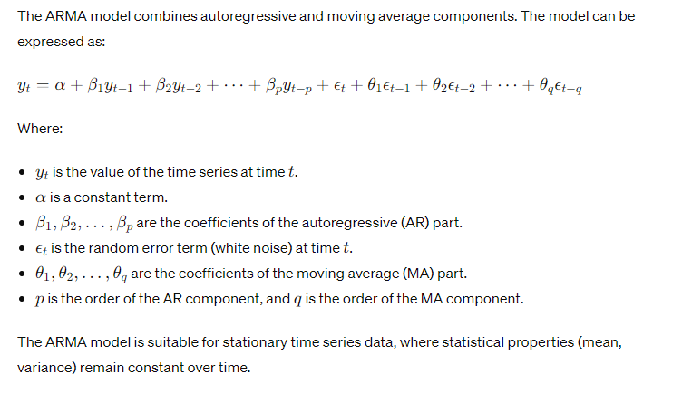
Autoregressive Moving Average (ARMA)

Slide 9
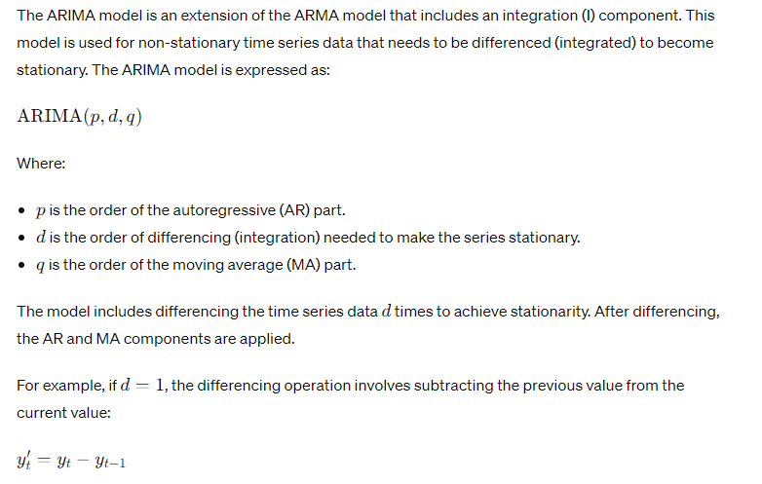
Autoregressive Integrated Moving Average (ARIMA)

Slide 10
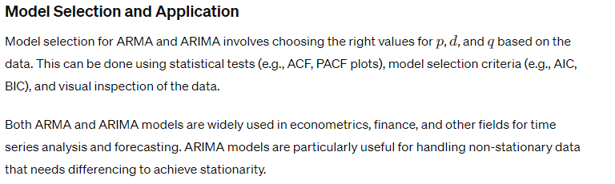
After differencing the series d times, an ARMA(p, q) model is applied to the differenced data.

Slide 11
Estimation of ARMA models such as Yule-Walker estimation for AR Processes
Estimating ARMA models can be done using various methods, such as the Yule-Walker equations for autoregressive (AR) processes.
Here's an overview of how the Yule-Walker estimation is used for AR processes, as well as a brief discussion of estimation methods for ARMA models.

Slide 12
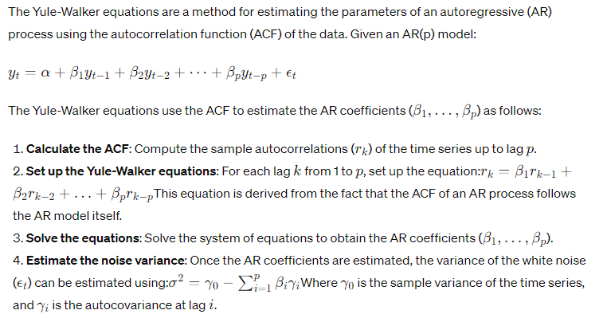
Yule-Walker Estimation for AR Processes

Slide 13
Yule-Walker estimation provides an efficient way to estimate AR model parameters, especially for stationary time series data.

Slide 14
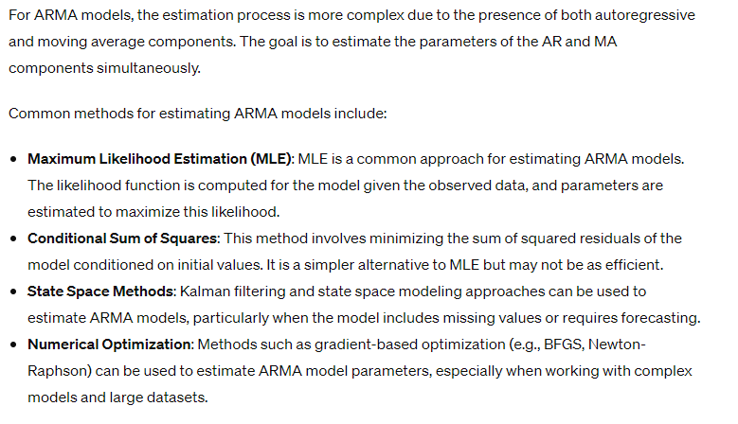
Estimation of ARMA Models

Slide 15
Selecting the appropriate method depends on the data and the specific characteristics of the time series.
Model selection criteria such as Akaike Information Criterion (AIC) and Bayesian Information Criterion (BIC) can be used to assess model fit and complexity when choosing among different ARMA models.

Slide 16
Maximum likelihood and least squares estimation for ARMA Processes
Estimating the parameters of Autoregressive Moving Average (ARMA) processes can be done using two main methods:
Maximum Likelihood Estimation (MLE) and Least Squares Estimation.
Both methods have their own strengths and applications in different scenarios.

Slide 17
Maximum Likelihood Estimation (MLE)
Maximum Likelihood Estimation is a method for estimating the parameters of a statistical model by maximizing the likelihood function.
The likelihood function measures the probability of observing the data given the parameters of the model.
For an ARMA model, the likelihood function is typically based on the assumption that the innovations (errors) are normally distributed.
Steps:
1.Define the likelihood function: The likelihood function for an ARMA model is based on the joint probability distribution of the time series data given the parameters. It involves expressing the model in terms of the likelihood of observing the data, which depends on the ARMA parameters and the variance of the noise.

Slide 18
2.Maximize the likelihood: Use numerical optimization methods (e.g., Newton-Raphson, BFGS) to find the parameters that maximize the likelihood function.
3.Compute standard errors: After estimating the parameters, standard errors can be calculated using the Fisher information matrix or other methods to assess the precision of the parameter estimates.
MLE is a powerful method for estimating ARMA models because it takes into account the full distribution of the data and provides asymptotically efficient estimates.

Slide 19
Least Squares Estimation
Least Squares Estimation is a simpler alternative to MLE, focusing on minimizing the sum of squared residuals (differences between observed and predicted values).
For ARMA models, there are two main types of least squares estimation:
Conditional Least Squares: This method minimizes the sum of squared residuals for the model, conditioned on initial values of the time series.
It may not account for the effects of initial conditions but can be computationally simpler.
Exact Least Squares: In this method, the residuals are minimized over the entire series, taking into account the full dependence structure of the ARMA model.
This method is more complex and computationally demanding than conditional least squares.

Slide 20
Steps:
Define the residuals: Compute the residuals for the ARMA model, which are the differences between the observed data and the model's predictions.
Minimize the sum of squared residuals: Use numerical optimization methods to find the parameters that minimize the sum of squared residuals.
Assess the model: Evaluate the model using diagnostics such as residual plots and model selection criteria (e.g., AIC, BIC).
Least Squares Estimation can be computationally simpler than MLE but may not account for the full distribution of the data, particularly in the case of exact least squares estimation.

Slide 21
Comparison
MLE is often preferred for its statistical efficiency and robustness, especially in large datasets and complex models. It provides the best linear unbiased estimates and accounts for the distribution of the data.
Least Squares Estimation is more straightforward and computationally simpler, making it a good choice when simplicity or computational speed is a priority. It may be a good option when the assumption of normally distributed residuals is not critical.
In practice, the choice of estimation method depends on the specific application, the size and nature of the data, and the computational resources available.

Slide 22
Forecasting using ARIMA models
Forecasting using Autoregressive Integrated Moving Average (ARIMA) models involves using the ARIMA model to predict future values of a time series based on its past observations.
ARIMA models are particularly well-suited for time series forecasting because they combine three components—autoregressive (AR), moving average (MA), and differencing (I)—to model different aspects of the data.

Slide 23
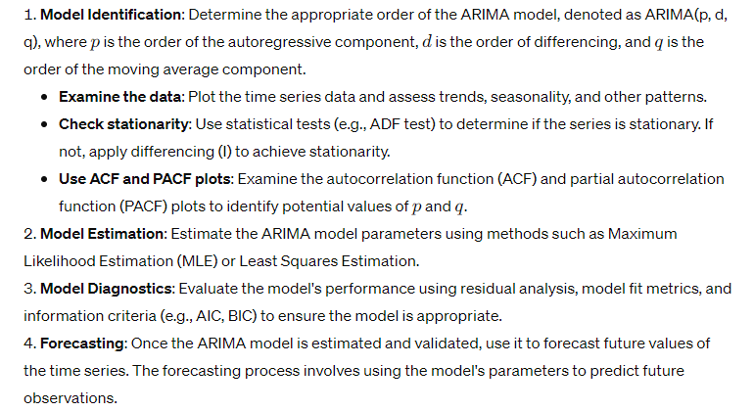
Steps for Forecasting using ARIMA Models

Slide 24
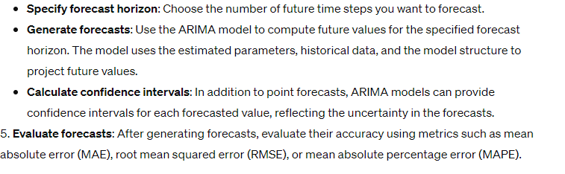

Slide 25
Key Points for Effective Forecasting
Data Preparation: Properly preprocess the time series data, including handling missing values and transforming non-stationary data to stationary.
Model Selection: Choose the ARIMA model order (p, d, q) carefully using model selection criteria such as AIC or BIC.
Model Validation: Assess the model's fit and diagnostics (e.g., residual analysis) to ensure it accurately represents the data.
Continuous Monitoring: Continuously monitor the model's performance and adjust the model as needed to maintain forecast accuracy.
Uncertainty Estimation: Consider the uncertainty of forecasts and provide confidence intervals for future values.

Slide 26
ARIMA models are widely used for time series forecasting in finance, economics, and other fields.
By following the appropriate steps and best practices, ARIMA models can provide reliable and accurate forecasts for future values of time series data.

Slide 27
CONTENTS
Prescriptive Analytics
Mathematical optimization
Networks modeling-Multi-objective optimization-Stochastic modeling
Decision and Risk analysis
Decision trees.

Slide 28
Prescriptive Analytics
Prescriptive analytics is a type of data analysis that goes beyond simply describing what has happened in the past (descriptive analytics) or predicting what might happen in the future (predictive analytics).
Instead, prescriptive analytics focuses on providing recommendations and actions to achieve desired outcomes based on the analysis of data.
Here are some key features and aspects of prescriptive analytics:
1.Decision-making support: Prescriptive analytics provides actionable insights and recommendations to help decision-makers choose the best course of action among several alternatives.
2.Optimization: It often involves using mathematical models, optimization techniques, and algorithms to identify the most effective solutions or strategies to achieve specific goals.
3.Scenario analysis: Prescriptive analytics can simulate different scenarios to understand potential outcomes and help organizations make more informed decisions.

Slide 29
4.Trade-offs and constraints: It takes into account various constraints and trade-offs, such as budget limitations, resource availability, and other operational restrictions.
5.Feedback loops: It often includes continuous monitoring and feedback mechanisms to adapt and improve decisions over time as new data becomes available.
6.Integration with other analytics types: Prescriptive analytics works alongside descriptive and predictive analytics to form a comprehensive approach to data-driven decision-making.
7.Applications: Prescriptive analytics can be applied in various industries, such as supply chain management, finance, healthcare, marketing, and transportation, to name a few.

Slide 30
Examples of prescriptive analytics include
Supply Chain Management: Determining the optimal inventory levels and reorder points to minimize costs while ensuring sufficient stock.
Healthcare: Recommending the most effective treatment plans for patients based on their medical history and current conditions.
Marketing: Identifying the best strategies for customer segmentation and targeting to maximize return on investment.
Finance: Optimizing portfolio allocation to maximize returns while managing risk.

Slide 31
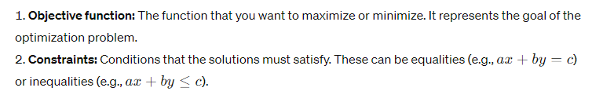
Mathematical Optimization
Mathematical optimization, also known as mathematical programming, is a branch of applied mathematics that focuses on finding the best solution from a set of feasible alternatives.
This solution is typically one that either maximizes or minimizes an objective function while satisfying a set of constraints.
Here are some key concepts and types of mathematical optimization:

Slide 32
3.Decision variables: The variables that can be adjusted to optimize the objective function.
4.Feasible region: The set of all possible solutions that satisfy the constraints.
5.Optimal solution: The best solution within the feasible region that maximizes or minimizes the objective function.

Slide 33
Types of mathematical optimization
1.Linear Programming (LP): Involves linear objective functions and linear constraints. It's a well-studied area with efficient algorithms such as the Simplex method and interior-point methods.
2.Integer Programming (IP): A special case of linear programming where some or all decision variables must take integer values. It is commonly used in scheduling, resource allocation, and other combinatorial optimization problems.
3.Nonlinear Programming (NLP): Deals with nonlinear objective functions and/or constraints. The problem is more complex than LP due to the non-convexity and potential for local optima.
4.Quadratic Programming (QP): A special case of nonlinear programming with a quadratic objective function and linear constraints.

Slide 34
5.Mixed-Integer Programming (MIP): Combines integer and continuous variables, making it useful for modeling complex decision-making problems.
6.Dynamic Programming: A method for solving optimization problems by breaking them down into simpler subproblems and solving them recursively.
7.Stochastic Programming: Considers uncertainty in the data, such as uncertain future demands or prices, and optimizes decisions under uncertainty.
8.Metaheuristics: These are algorithmic approaches that find near-optimal solutions to complex optimization problems, especially when exact methods are infeasible. Examples include genetic algorithms, simulated annealing, and ant colony optimization.

Slide 35
Applications of mathematical optimization can be found across various fields such as logistics and supply chain management, finance, engineering, operations research, and many more.
The goal is always to improve decision-making and efficiency by finding the optimal solution to a given problem.

Slide 36
Networks modeling-Multi-objective optimization-Stochastic modeling (also refer my notes for problems)
Networks modeling involves the study and creation of abstract representations of systems in which various entities (nodes) are interconnected (by edges).
These models are crucial for understanding, analyzing, and optimizing the structure and behavior of different types of networks. Here’s a more detailed look into networks modeling
Key Concepts in Networks Modeling
1.Graph Theory:
Vertices (Nodes): Represent entities or objects within the network.
Edges (Links): Represent connections or relationships between nodes.
Directed vs. Undirected Graphs: Directed graphs have edges with a direction, indicating a one-way relationship. Undirected graphs have bidirectional edges.
Weighted Graphs: Edges have weights representing the strength or capacity of the connection.

Slide 37
2. Types of Networks:
Social Networks: Model relationships between individuals or organizations (e.g., friendships, professional connections).
Computer Networks: Represent the interconnections between computers and devices (e.g., the internet, LANs).
Transportation Networks: Model pathways and routes in transportation systems (e.g., roads, air routes).
Biological Networks: Represent interactions within biological systems (e.g., protein-protein interaction networks, neural networks).
Supply Chain Networks: Model the flow of goods, information, and finances within supply chains.

Slide 38
Methods and Techniques
1.Network Analysis:
Centrality Measures: Identify the most important nodes within the network (e.g., degree centrality, betweenness centrality, closeness centrality).
Community Detection: Identify clusters or groups of nodes that are more densely connected with each other than with the rest of the network.
Path Analysis: Study the shortest or most efficient paths between nodes (e.g., shortest path algorithms, Dijkstra’s algorithm).

Slide 39
2.Network Simulation:
Agent-Based Modeling: Simulate the actions and interactions of autonomous agents to assess their effects on the network as a whole.
Monte Carlo Simulation: Use repeated random sampling to model and analyze complex networks and their behaviors
3. Optimization in Networks:
Flow Optimization: Maximize or minimize the flow through a network (e.g., maximizing data throughput in computer networks).
Network Design: Optimize the structure of the network to achieve desired properties (e.g., robustness, cost-efficiency).

Slide 40
Applications
1.Internet and Telecommunications:
Optimize routing protocols to improve data transfer efficiency and reduce latency.Design resilient network infrastructures to withstand failures and attacks.
2.Transportation Systems:
Plan and optimize routes for reducing travel time and congestion.Design efficient public transportation networks.Supply Chain Logistics:Optimize the flow of goods and materials to reduce costs and improve delivery times.Model and mitigate risks in the supply chain.
3. Supply Chain Logistics:
Optimize the flow of goods and materials to reduce costs and improve delivery times.
Model and mitigate risks in the supply chain.

Slide 41
4.Social Network Analysis:
Study the spread of information, influence, and behaviors through social networks.
Detect and understand community structures and key influencers.
5.Biological Systems:
Model and analyze the interactions between different biological entities.
Understand the dynamics of disease spread and develop strategies for intervention.

Slide 42
Tools and Software
NetworkX: A Python library for the creation, manipulation, and study of complex networks.
Gephi: An open-source software for network visualization and analysis.
Pajek: A program for large network analysis.
Cytoscape: An open-source platform for complex network analysis and visualization, especially used in bioinformatics.

Slide 43
Multi-objective optimization
Multi-objective optimization is the process of simultaneously optimizing two or more conflicting objectives subject to certain constraints.
This type of optimization is essential in many real-world applications where trade-offs between different goals must be considered.
Key Concepts
1.Objectives:
Functions to be optimized (minimized or maximized).Common examples include cost, quality, performance, and time.
2.Pareto Optimality:A solution is Pareto optimal if no other solution can improve one objective without worsening another.
The set of all Pareto optimal solutions forms the Pareto front or Pareto frontier.

Slide 44
3.Trade-offs:
Improving one objective often leads to the degradation of another.
The goal is to find a balance or acceptable compromise between conflicting objectives.
Methods and Techniques
1.Weighted Sum Method:
Combine multiple objectives into a single objective by assigning weights to each objective and summing them.
Simple but requires proper weighting, which can be challenging.
2.Pareto-based Methods:
Genetic Algorithms (e.g., NSGA-II): Utilize evolutionary principles to find a diverse set of Pareto optimal solutions.
Pareto Simulated Annealing: Integrates simulated annealing with Pareto principles to explore the solution space.

Slide 45
3.Scalarization Techniques:
Convert multiple objectives into a single objective.
Epsilon-Constraint Method: Optimize one objective while treating others as constraints.
4. Interactive Methods:
Involve decision-makers during the optimization process to iteratively refine solutions.
Examples include interactive evolutionary algorithms and reference point methods.

Slide 46
Applications
1.Engineering Design:
Optimize product designs for factors like weight, strength, and cost
Balance performance with environmental impact in product development.
2.Economics and Finance:
Portfolio optimization balancing return and risk.
Economic policy design considering growth, inflation, and unemployment rates.
3.Environmental Management:
Optimize resource allocation for conservation and development.
Balance economic growth with environmental sustainability.
4.Supply Chain Management:
Optimize logistics for cost, delivery time, and reliability.
Balance inventory levels with service quality.

Slide 47
5.Healthcare:
Optimize treatment plans balancing efficacy and side effects.
Design healthcare policies balancing cost, accessibility, and quality.

Slide 48
Stochastic modeling
Stochastic modeling involves the use of probability and random variables to represent and analyze systems that are inherently uncertain.
This type of modeling is crucial in many fields such as finance, engineering, science, and operations research, where uncertainty and variability play significant roles.

Slide 49
Key Concepts
1.Random Variables:
Variables whose values result from random phenomena.
Can be discrete (e.g., the number of heads in coin tosses) or continuous (e.g., the time between arrivals of buses).
2.Probability Distributions:
Describe how probabilities are distributed over the values of a random variable.
Common distributions include normal, binomial, Poisson, and exponential distributions.

Slide 50
3.Stochastic Processes:
Collections of random variables representing the evolution of a system over time.
Examples include Markov processes, Brownian motion, and Poisson processes.
4. Monte Carlo Simulation:
A method that uses repeated random sampling to obtain numerical results.
Often used to estimate the probability of different outcomes in a process that cannot easily be predicted due to the intervention of random variables.

Slide 51
Methods and Techniques
1.Markov Chains:
Stochastic models where the future state depends only on the current state and not on the sequence of events that preceded it (memoryless property).
Used in areas like queueing theory, inventory management, and finance.
2. Poisson Processes:
Models that represent events occurring randomly over a fixed period or space.
Commonly used to model arrival times of customers in a queue, phone calls, or decay of radioactive particles.

Slide 52
3.Monte Carlo Methods:
Techniques that rely on random sampling to solve problems that might be deterministic in principle.
Used in finance for option pricing, risk management, and in engineering for reliability analysis.
4. Brownian Motion:
A continuous-time stochastic process used to model random movements over time.
Foundational in the modeling of stock prices and other financial instruments.

Slide 53
5.Stochastic Differential Equations (SDEs):
Differential equations in which one or more terms are stochastic processes.
Used to model systems affected by random shocks or noise.

Slide 54
Decision and Risk analysis
Decision and risk analysis involves systematically evaluating and making decisions in the presence of uncertainty.
This field combines principles from economics, statistics, psychology, and operations research to help decision-makers choose the best course of action considering both potential outcomes and their associated risks.
Key Concepts
1.Decision Analysis:
The process of evaluating and choosing among alternative courses of action.
Involves defining objectives, identifying alternatives, assessing the consequences, and making trade-offs.

Slide 55
2.Risk Analysis:
The process of identifying, assessing, and prioritizing risks.
Involves both qualitative and quantitative methods to estimate the likelihood and impact of different risks.
3. Expected Utility Theory:
A framework for making rational decisions under uncertainty.
Decision-makers choose the alternative that maximizes their expected utility, a measure of satisfaction or value.

Slide 56
4.Bayesian Decision Theory:
Uses Bayes' theorem to update the probability of outcomes based on new evidence.
Incorporates prior beliefs and evidence to make informed decisions.
5.Multi-Criteria Decision Analysis (MCDA):
A set of methods for evaluating decisions involving multiple criteria.
Examples include the Analytic Hierarchy Process (AHP) and Technique for Order of Preference by Similarity to Ideal Solution (TOPSIS).

Slide 57
Methods and Techniques
1.Decision Trees:
Graphical representations of decision processes, including decision nodes, chance nodes, and end nodes.
Useful for visualizing and analyzing complex decision problems.
2. Influence Diagrams
A more compact representation than decision trees, showing relationships between decisions, uncertainties, and objectives.
Nodes represent decisions, uncertainties, and objectives, while arcs represent dependencies.

Slide 58
3.Monte Carlo Simulation:
A computational technique that uses random sampling to estimate the probability distribution of outcomes.
Commonly used for risk analysis and financial modeling.
4. Sensitivity Analysis:
Examines how changes in input variables affect the outcomes of a decision model.
Helps identify critical variables and assess the robustness of decisions.
5.Scenario Analysis:
Evaluates the impact of different scenarios on decision outcomes.
Involves constructing and analyzing plausible future states to understand potential risks and opportunities.

Slide 59
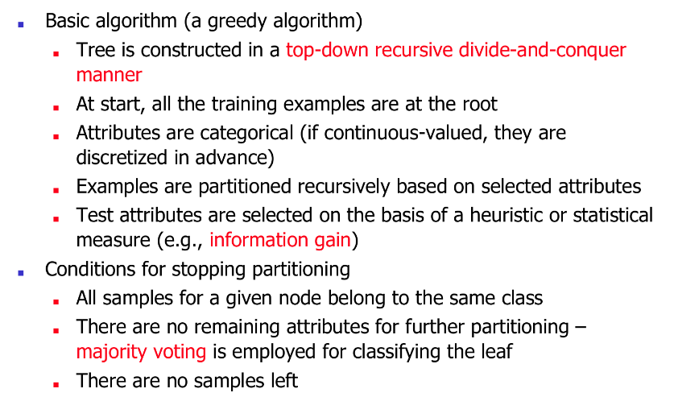
Algorithm for Decision Tree Induction

Slide 60
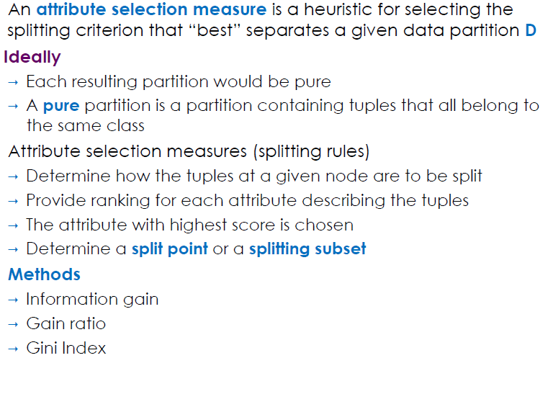
Attribute Selection Measures

Slide 61
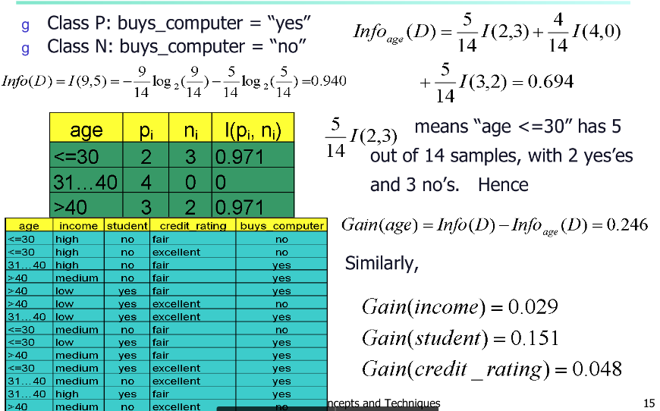
Attribute Selection: Information Gain

Slide 62
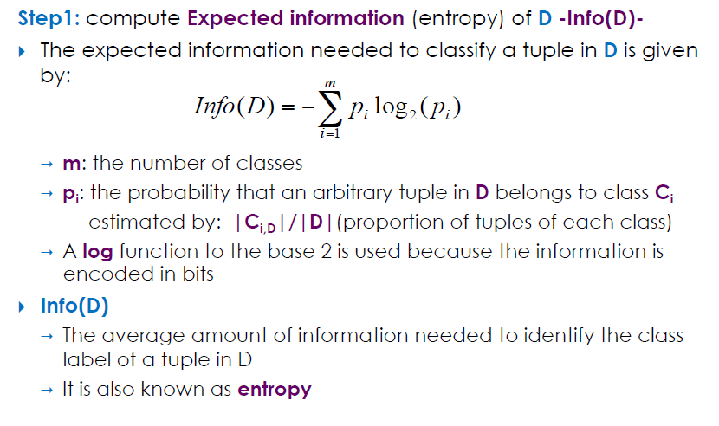
Information Gain Approach

Slide 63
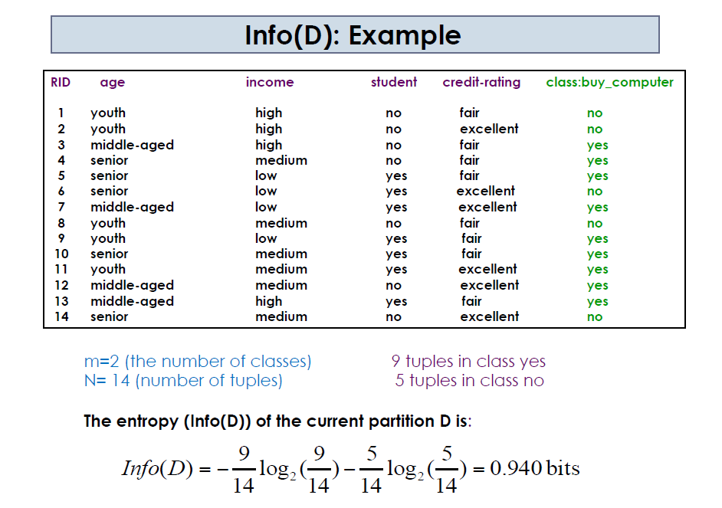

Slide 64
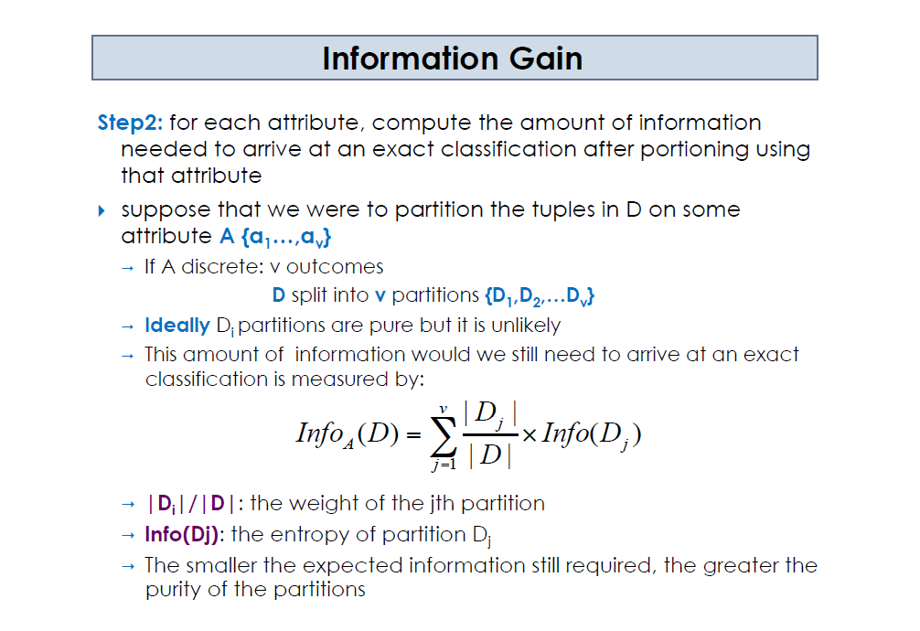

Slide 65
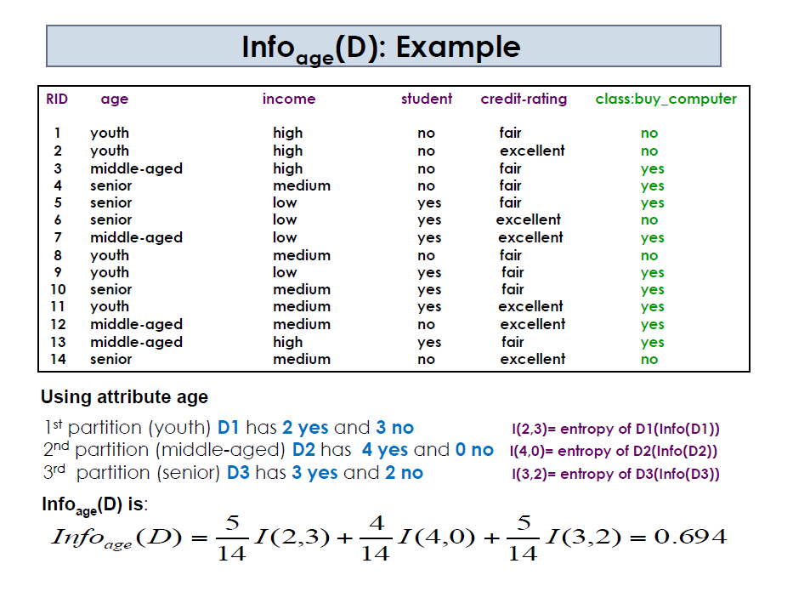

Slide 66
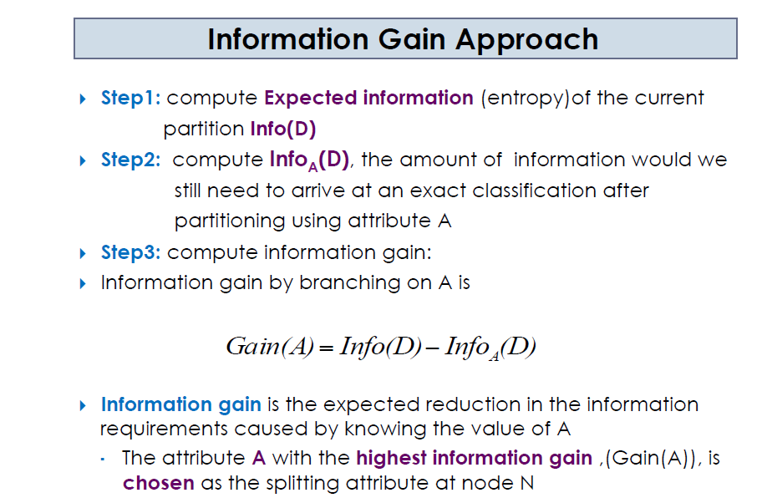

Slide 67
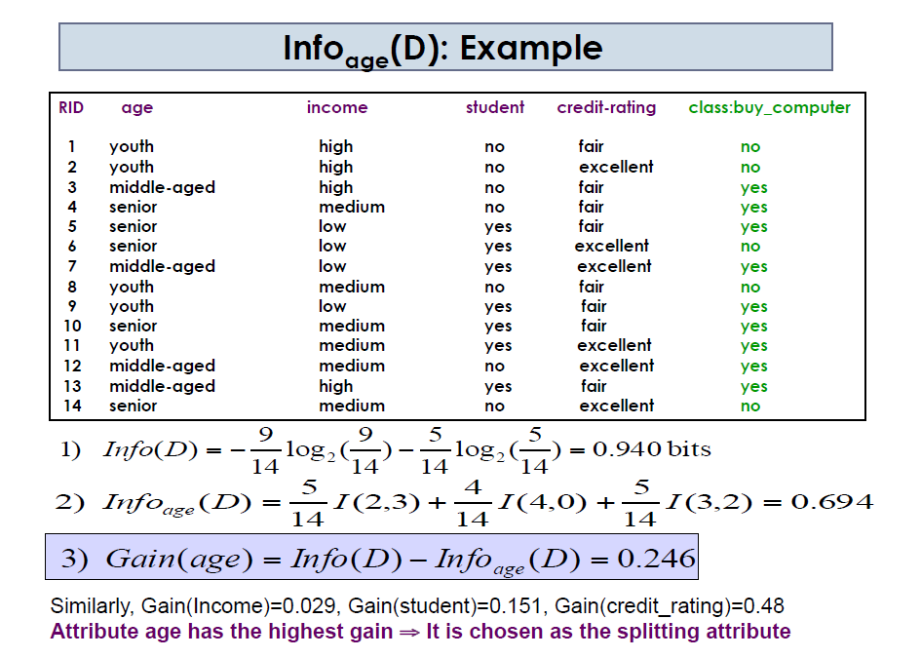

Slide 68
Refer Problems for
Maximum Likelihood estimation , stochastic process modelling and Truth tables (AND,,,,)

